Slide 1
BOOK RECOMMENDATION SYSTEM
PRESENT BY:SHAH VIDHI(210050131509)
ROHIT MITTAL(210050131511)

Slide 2
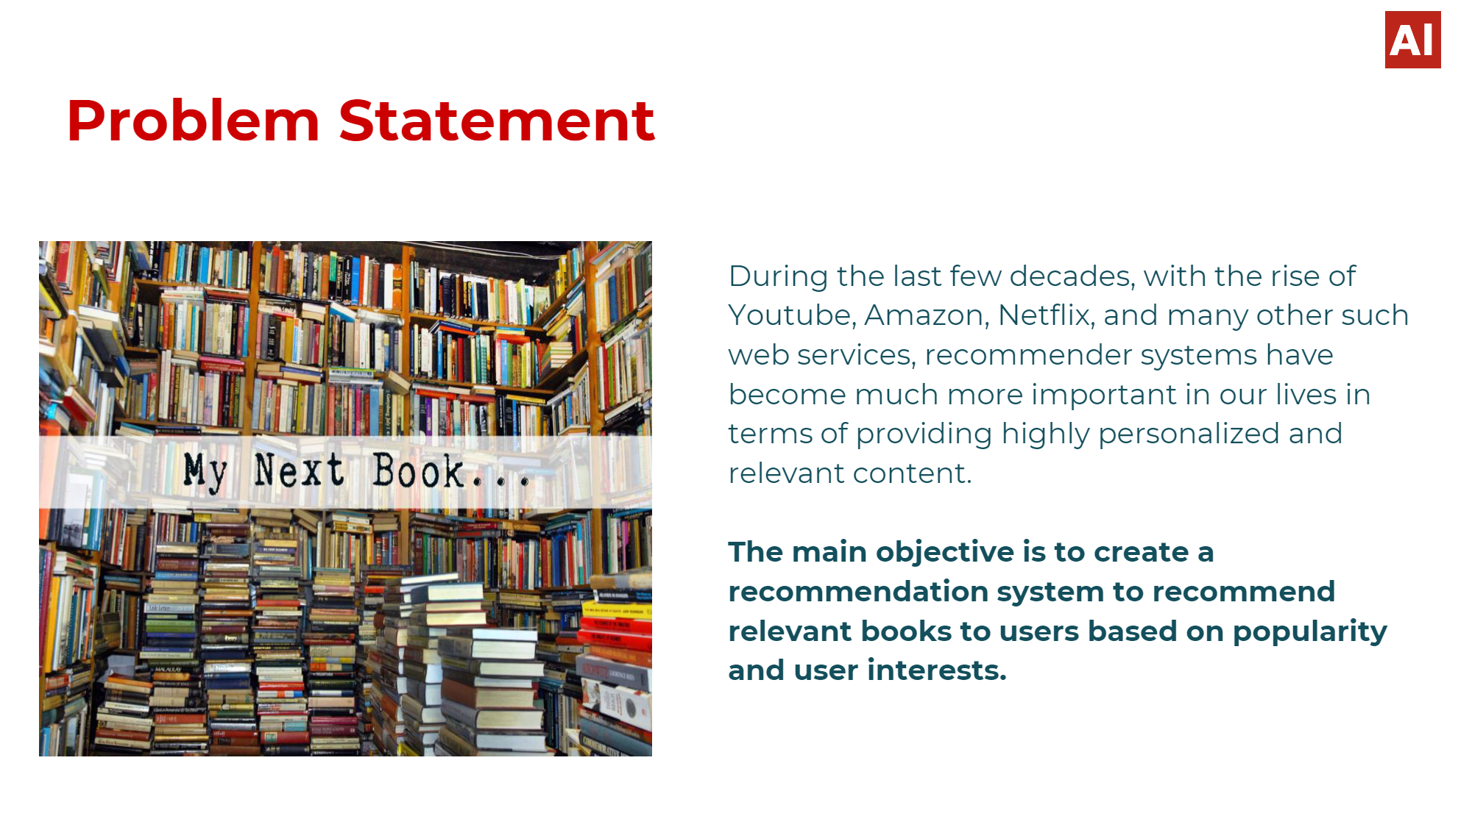
INTRODUCTION:
Now-a-days, everyone depending on reviews by others in many things such as selecting a movie to watch, buying products, reading a book.
Recommender systems are used for that purpose only. A recommender system is a kind of filtering system that predicts a user's rating of an item.

Slide 3
A book recommendation system is a type of recommendation system where we have to recommend similar books to the reader based on his interest. The books recommendation system is used by online websites which provide ebooks like google play books, open library, good Read’s, etc.
we will use the Collaborative based filtering method to build a book recommender system.
Recommender systems recommend items to users by filtering through a large database of information using a ranked list of predicted ratings of items.
Online Book recommender system is a recommender system for ones who love books. When selecting a book to read, individuals read and rely on the book ratings and reviews that previous users have written.

Slide 4
DATA SET:
The Book-Crossing dataset comprises 3 files.
Users:
Contains the users. Note that user IDs (User-ID) have been anonymized and map to integers.
Demographic data is provided (Location, Age) if available. Otherwise, these fields contain NULL-values.
2.Books:
Books are identified by their respective ISBN. Invalid ISBNs have already been removed from the dataset. Moreover, some content-based information is given (Book-Title, Book-Author, Year-Of-Publication, Publisher).
3.Ratings:
Contains the book rating information.
Ratings(Book-Rating) are either explicit, expressed on a scale from 1-10 (higher values denoting higher appreciation), or implicit, expressed by 0.

Slide 5
CONCLUSTION:
This book recommender provides the user with an original, simple to use, book recommendation system emphasizing on interest book recommendations.

Slide 6
THANK YOU

